Slide 1
Prepare a max 5’ pitch based on what you've seen in weeks 1, 2 and 3. It must include:
your value proposition (week 1),
at least one persona & pathway (week 2),
at least one identified assumptions and its proposed test (week 3).

Slide 2
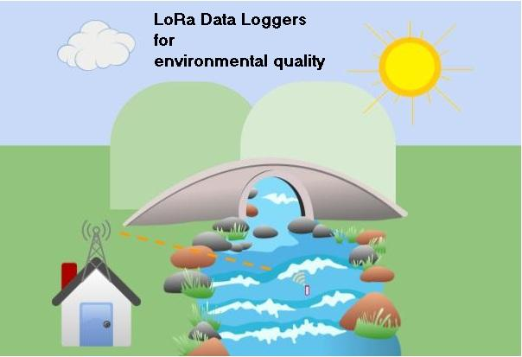

EcoSen

Slide 3
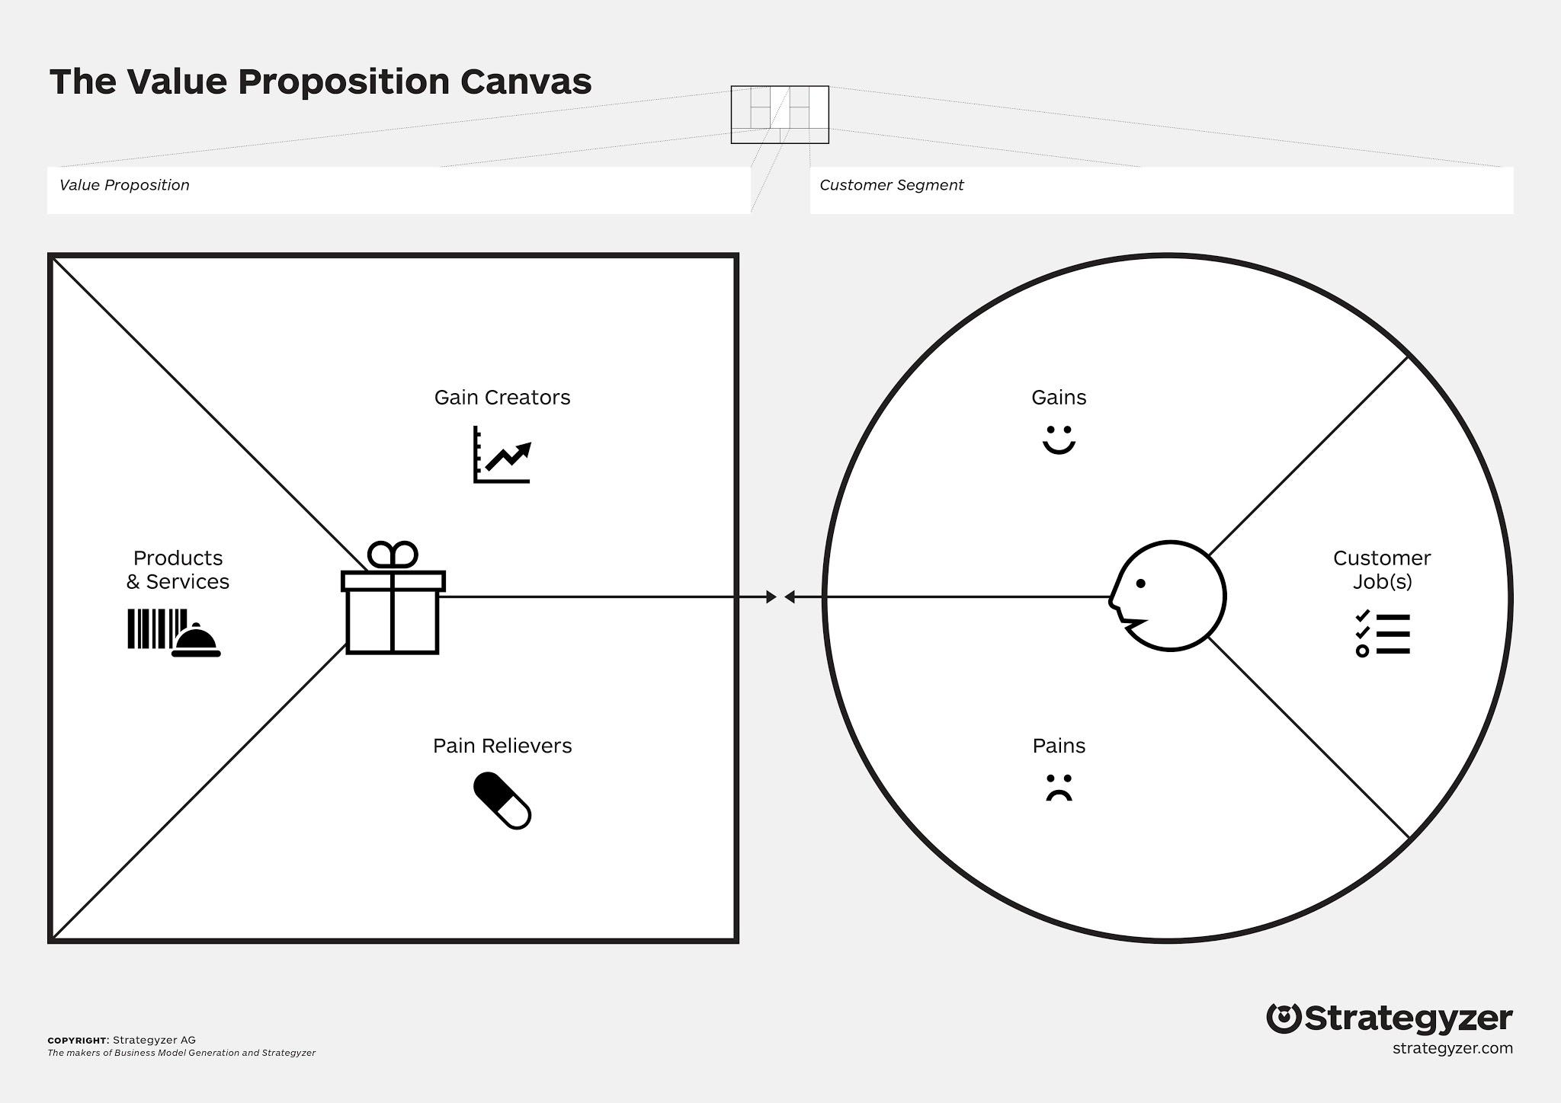
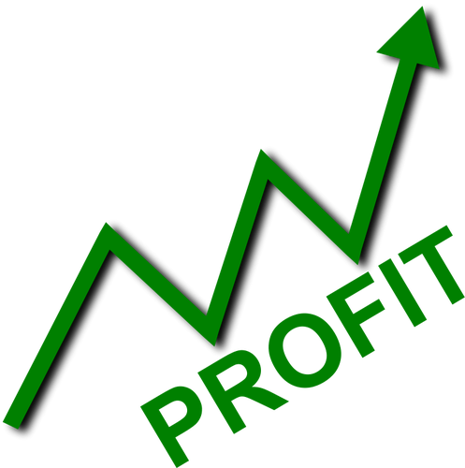








Data logger for environmental variables
Ecology and Animal Diversity Institute (IDEA)
Take accurate data at real time
Help people affected by environmental degradation to be informed
More papers
Cost effective data acquisition
Repairable hardware
Scientific dissemination
Data logger
Cheap
Replicable
Customisable
Open access
Wireless
Linked to a friendly graphic interface
Take accurate and reliable data
Publish papers
Reports
Bring information to the society
Cheap
Open
Reduced maintenance costs
Lower monitoring costs
Expensive sensors
Travel cost to take data
Known state of sensors

Slide 4
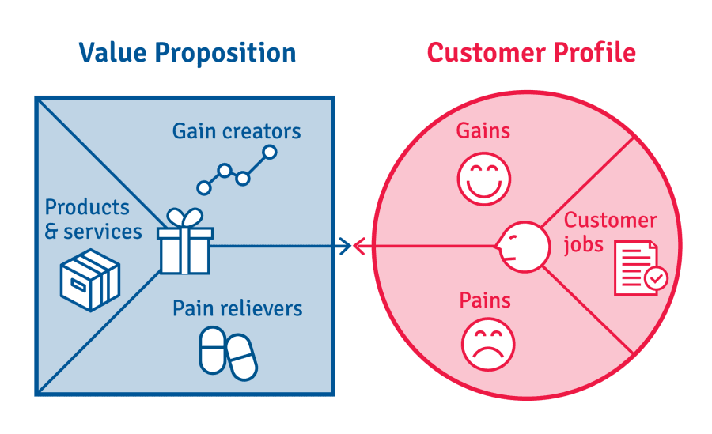
User/Contributor profile
Personas

Slide 5
Personas: José (Contributor)
José is an advanced electrical engineering student. He want to specialize in environmental sensors. He has no yet begin his graduation thesis
Jobs: Graduate from college. He wants to make an environmental sensor that can also be a part of his graduation thesis. He needs to get his sensors calibrated by biologists.
Pains: He doesn’t know how to connect with people from other disciplines. He can’t validate the measurements of his sensors himself.
Gains: He would like to find an applicability for his sensors. He would like to get experience in working in interdisciplinary work. He would like to learn the use of repositories and open projects documentation

Slide 6

Pathways

Slide 7
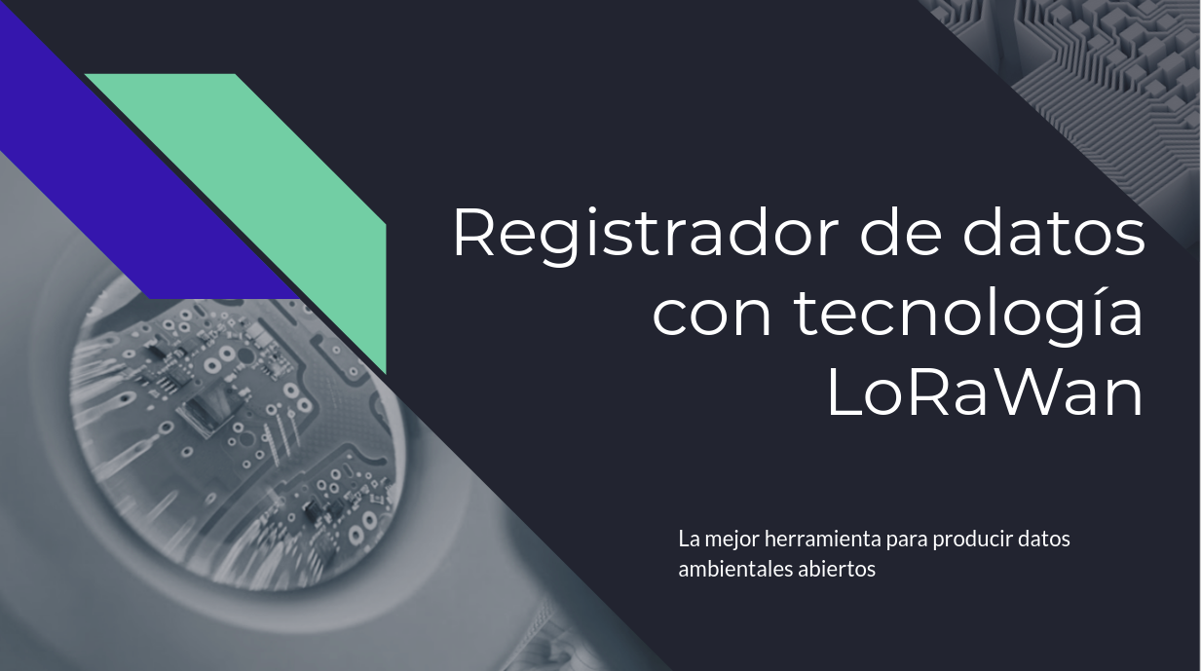
Slides for presenting to contributors

Slide 8
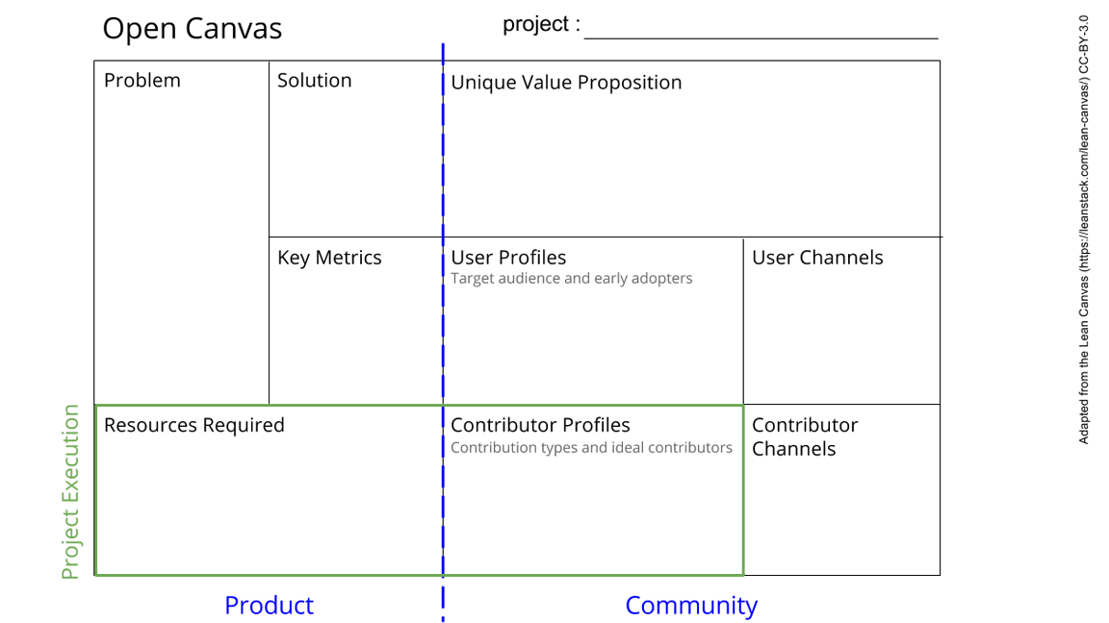
LoRa Data Loggers
We offer accurate, reliable, continuous and open information about the environmental state of freshwater resources.
1. It will solve the lack of attention and credibility of environmental problems.
2. People will have more data to claim about their rights.
3. Scientists will have more data to make papers.
4. Goverment will have more data to demostrate their remediation policies
*Suquía River environmental degradation
*Produce a device for measurements of water quality, open, cheap, customisable, replicable, that can be able to send constant and wireless information.
*Give tools to the society to afford the problematic of environmental pollution
*Make a real time source of environmental data
*LoRa Data Loggers
*An Open data base with environmental information
* # scientific institutions interested
*#Scientists interested
*#High schools interested
*Open database traffic
*Environmental Scientists
*High schools
*Scientific Institutions.
*Citizens
*Environmental activists
*Goverments
*Tutorials
*Web site
*Social networks
*Money
*microcontrolers
*sensors
*trained people
*Grants
*Hobbists
*Environmental activists
*Educators
*Scientist
*Engineers.
*Teachers
*Slides
*Surveys
*Internships
*Scientific research
See next slide for instructions!
Notes:
Go to File > Make a Copy… to make your own canvas
See next slide for instructions

Slide 9
Tests

Slide 10
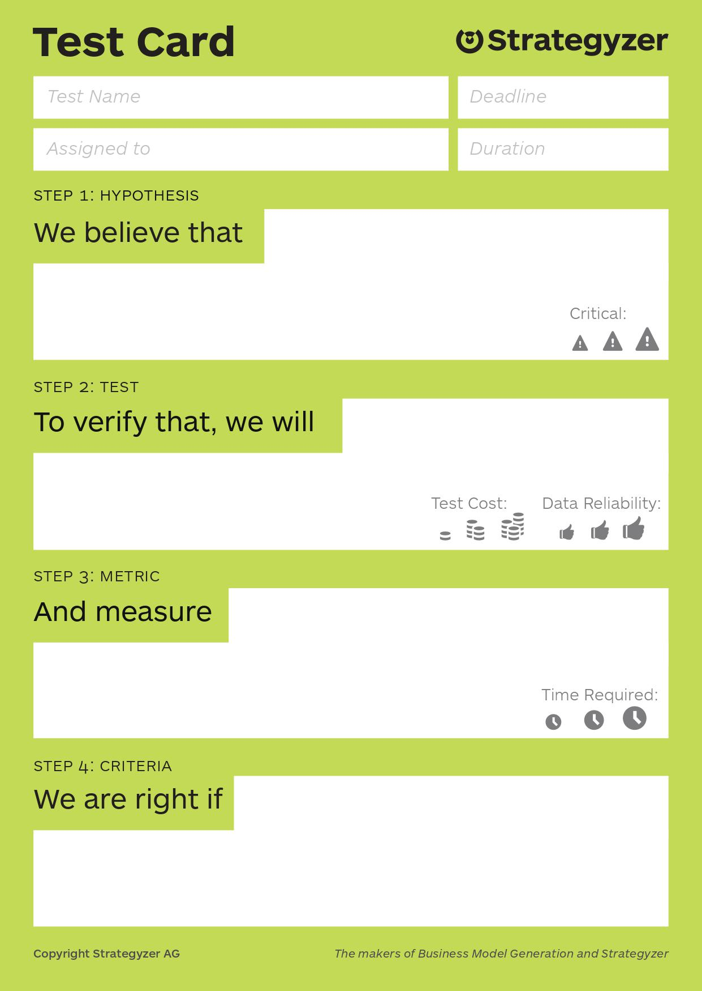
Open data base
Users are interested in put the data logger collected information in an Open data base
gonna do a survey
How many user agree to make your data open
Most users are ok with this idea

Slide 11
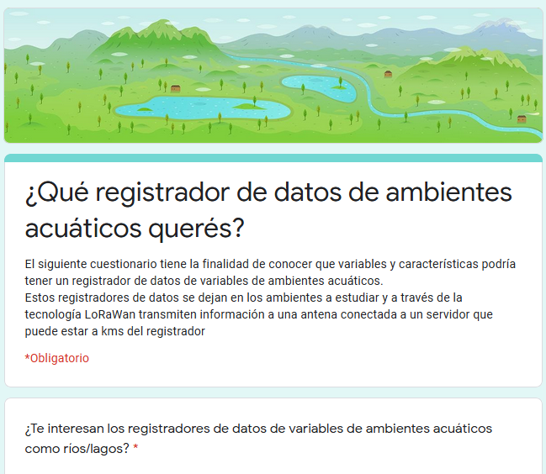
Electronic surveys
High schools, city councils, Scientists
To know what are the needs of potential users

Slide 12
END

Slide 13
Simplify
Describe Results/Benefits
Focus on problems
Practice

Slide 14
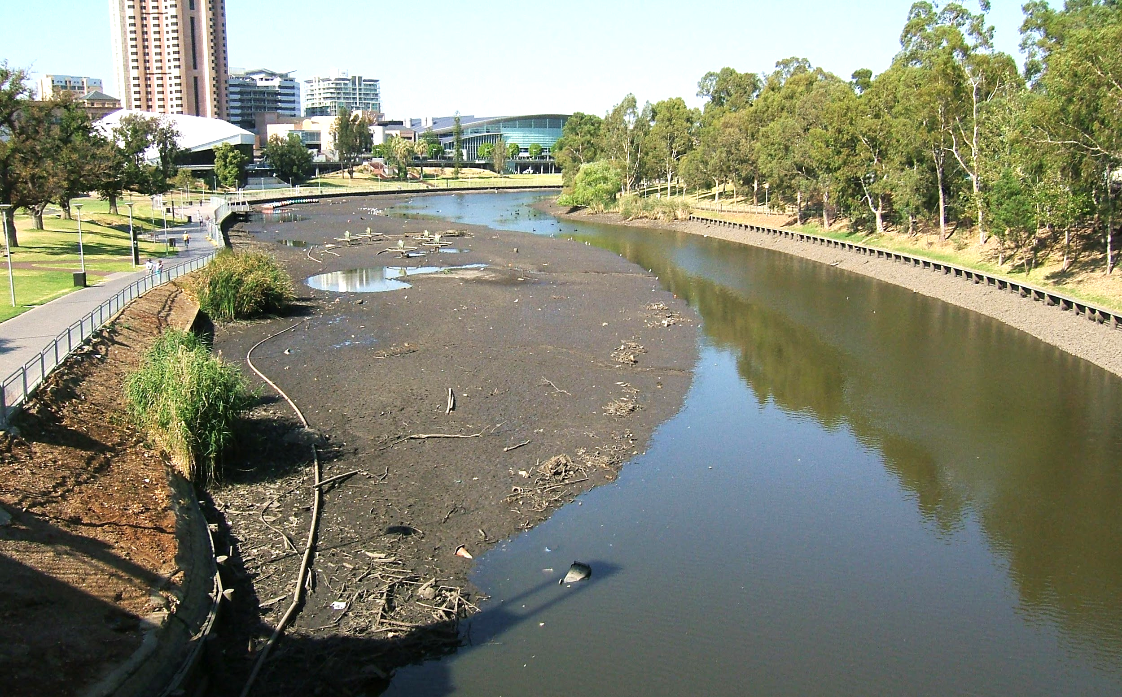
Problem
Low quality of freshwater bodies
Expensive and privative data loggers
Low amount of accurate data about the environmental quality of rivers and lakes

Slide 15
Personas: Natalia (User)
Natalia is a scientific researcher studying the effect of environmental degradation in invertebrates communities of Luján streams
Jobs: Design samplings to get representative samples of bentos to compare with different conditions zones in the stream. After that, produce high impact scientific articles.
Pains: She have some problems to relate the composition of assembles with the particular conditions of water at the time of samplings. She have also some economical limitations for samples recollection and equipment manteinance.
Gains: She would like to have more quality and quantity of environmental data. Have more novelty data. To give more social relevance to her studies.

Slide 16
Personas: Victoria (User)
Victoria is a Chacra La Merced neighbour. She and some of her friends lives near the Suquía River and they see it as a threath to public health. She and her friends want to do a report about the pollution and dangers related to the river and to be disseminated in the media
Jobs: Pass the course. Care the family’s livestock. Finish high school.
Pains: That some relative get sick by pollution. Do not pass the course. Do not find a job.
Gains: She wants to know safe zones to walk. That state make remediation actions. Finish high school.

